Slide 1
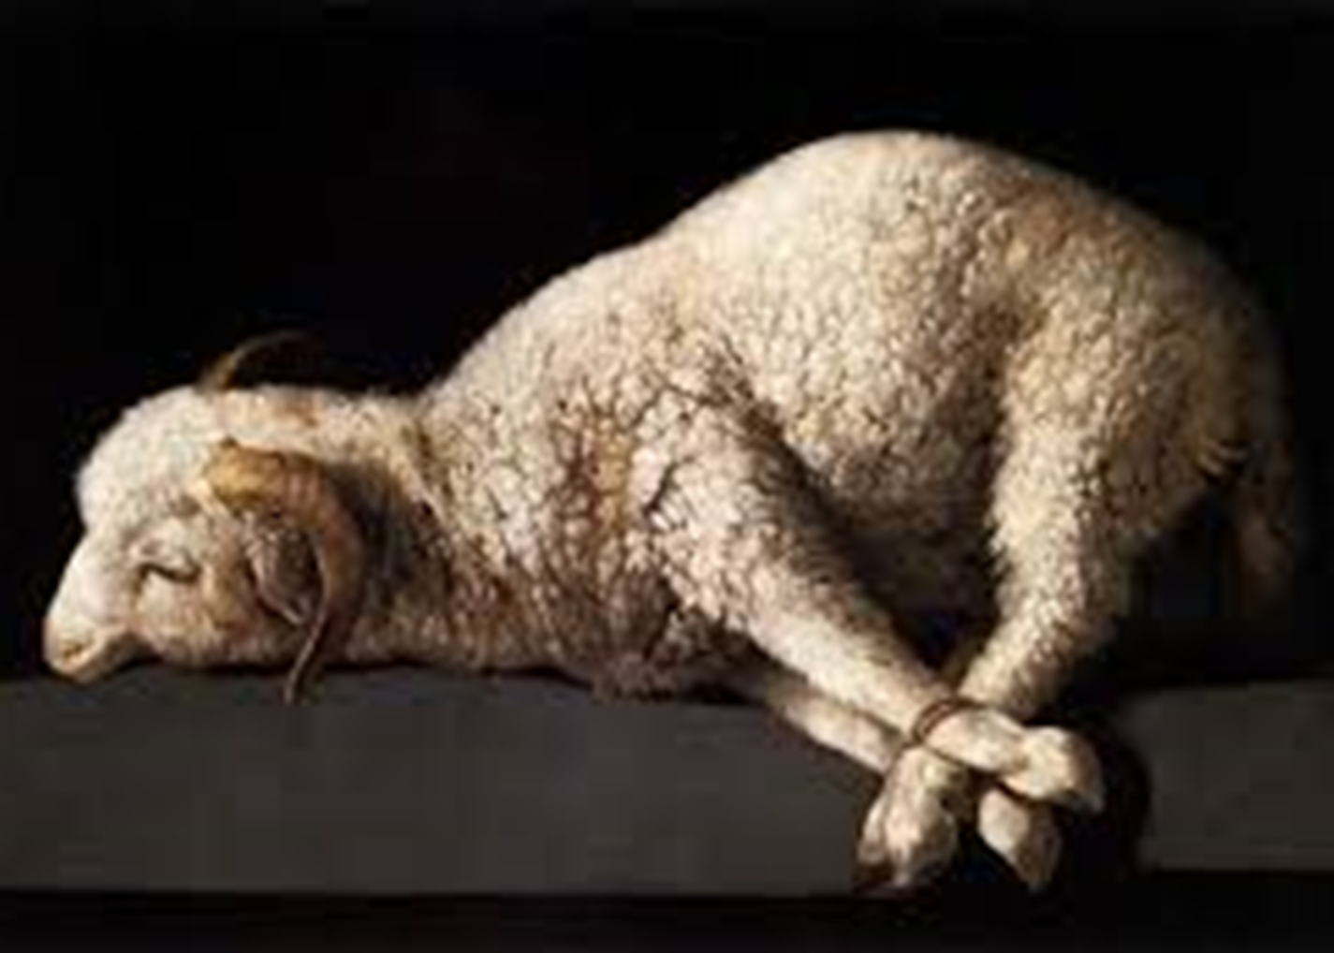
Preparation for God’s Rest Part 2: The Son of God
Hebrews 4:12-16
February 6, 2022

Slide 2
Hebrews 4:12-13
¹² For the word of God is living and active and sharper than any two-edged sword, and piercing as far as the division of soul and spirit, of both joints and marrow, and able to judge the thoughts and intentions of the heart. ¹³ And there is no creature hidden from His sight, but all things are open and laid bare to the eyes of Him with whom we have to do.

Slide 3
Hebrews 4:14-16
¹⁴ Therefore, since we have a great high priest who has passed through the heavens, Jesus the Son of God, let us hold fast our confession. ¹⁵ For we do not have a high priest who cannot sympathize with our weaknesses, but One who has been tempted in all things as we are, yet without sin. ¹⁶ Therefore let us draw near with confidence to the throne of grace, so that we may receive mercy and find grace to help in time of need.

Slide 4
Preparation to Enter God’s Rest
Three part series
I. The Word of God (4:12-13)
II. The Son of God (4:14-15)
III. The Grace of God (4:16)

Slide 5
I. The Word will Accomplish its task (4:12)
For the word of God is living and active and sharper than any two-edged sword
A. The Word is alive (12a)
B. The Word is sharp (12b)

Slide 6
II. The Word is Accurate (4:12)
And piercing as far as the division of soul and spirit, of both joints and marrow, and able to judge the thoughts and intentions of the heart.
A. The Word is Penetrating (12c)
B. The Word is Discerning (12d)

Slide 7
III. The Word will Anatomize (4:13)
And there is no creature hidden from His sight but all things are open and laid bare to the eyes of Him with whom we have to do.
A. The Word reveals God to us (13a)
1. The Omniscience of God
2. The Omnipresence of God
B. The Word reveals us to us (13b)
1. The sin that remains
2. The true motives of the heart

Slide 8
IV. Our Great High Priest (4:14)
Therefore, since we have a great high priest who has passed through the heavens, Jesus the Son of God, let us hold fast our confession.
A. Believers Possess a Great High Priest (14a)
Echo – “possess” or “to hold” we read it as “having”

Slide 9
Hebrews 7:26-28
²⁶ For it was fitting for us to have such a high priest, holy, innocent, undefiled, separated from sinners and exalted above the heavens; ²⁷ who does not need daily, like those high priests, to offer up sacrifices, first for His own sins and then for the sins of the people, because this He did once for all when He offered up Himself. ²⁸ For the Law appoints men as high priests who are weak, but the word of the oath, which came after the Law, appoints a Son, made perfect forever.

Slide 10
IV. Our Great High Priest (4:14)
Therefore, since we have a great high priest who has passed through the heavens, Jesus the Son of God, let us hold fast our confession.
A. Believers Possess a Great High Priest (14a)
B. Jesus Passed Through the Heavens (14b)
Ouranos – the visible heavens, the atmosphere, the sky, the starry heavens, the spiritual heavens.

Slide 11
2 Corinthians 12:2-4
² I know a man in Christ who fourteen years ago—whether in the body I do not know, or out of the body I do not know, God knows—such a man was caught up to the third heaven [ouranos]. ³ And I know how such a man—whether in the body or apart from the body I do not know, God knows— ⁴ was caught up into Paradise and heard inexpressible words, which a man is not permitted to speak.

Slide 12
Acts 11:5
⁵ “I was in the city of Joppa praying; and in a trance I saw a vision, an object coming down like a great sheet lowered by four corners from the sky [ouranos]; and it came right down to me.

Slide 13
IV. Our Great High Priest (4:14)
Therefore, since we have a great high priest who has passed through the heavens, Jesus the Son of God, let us hold fast our confession.
A. Believers Possess a Great High Priest (14a)
B. Jesus Passed Through the Heavens (14b)
C. Believers Seize Your Confession (14c)
Kratomen – “Hold”, “To use strength”, “Seize”, “Or to retain.”

Slide 14
Ephesians 2:8-9
⁸ For by grace you have been saved through faith; and that not of yourselves, it is the gift of God; ⁹ not as a result of works, so that no one may boast.

Slide 15
Romans 8:35
³⁵ Who will separate us from the love of Christ? Will tribulation, or distress, or persecution, or famine, or nakedness, or peril, or sword?

Slide 16
Ephesians 1:3-6
³ Blessed be the God and Father of our Lord Jesus Christ, who has blessed us with every spiritual blessing in the heavenly places in Christ, ⁴ just as He chose us in Him before the foundation of the world, that we would be holy and blameless before Him. In love ⁵ He predestined us to adoption as sons through Jesus Christ to Himself, according to the kind intention of His will, ⁶ to the praise of the glory of His grace, which He freely bestowed on us in the Beloved.

Slide 17
1 John 2:18-20
¹⁸ Children, it is the last hour; and just as you heard that antichrist is coming, even now many antichrists have appeared; from this we know that it is the last hour. ¹⁹ They went out from us, but they were not really of us; for if they had been of us, they would have remained with us; but they went out, so that it would be shown that they all are not of us. ²⁰ But you have an anointing from the Holy One, and you all know.

Slide 18
V. Our Sympathetic High Priest (4:15)
For we do not have a high priest who cannot sympathize with our weaknesses, but One who has been tempted in all things as we are, yet without sin.
A. He Knows Our Weaknesses (15a)
Ou – “Not” is an absolute negative adverb
Me - “Not” but also can be “lest”, “not”, “whether”, or “also”
Sumpatheo – “Sympathize”, “Compassion”, “Understanding”
“touched with the feeling of our infirmities.”
Hemon – “Of us” This makes it personal to each of us.

Slide 19
V. Our Sympathetic High Priest (4:15)
For we do not have a high priest who cannot sympathize with our weaknesses, but One who has been tempted in all things as we are, yet without sin.
A. He Knows Our Weaknesses (15a)

Slide 20
Experiences of a Sympathetic High Priest
Jesus knew what it was like to experience poverty
Jesus knew what it was like to experience exhaustion
Jesus knew what it was like to experience betrayal
Jesus knew what it was like to experience grief
Jesus knew what it was like to experience temptation
Jesus knew what it was like to experience suffering
Jesus knew what it was like to experience the turning away of God – forsaken

Slide 21
V. Our Sympathetic High Priest (4:15)
For we do not have a high priest who cannot sympathize with our weaknesses, but One who has been tempted in all things as we are, yet without sin.
A. He Knows Our Weaknesses (15a)
B. He Has Been Tempted Without Sin (15b)
Homoiotes – “Like” – “Heaven is Like…”

Slide 22
Matthew 12:9-12
⁹ Departing from there, He went into their synagogue. ¹⁰ And a man was there whose hand was withered. And they questioned Jesus, asking, “Is it lawful to heal on the Sabbath?”—so that they might accuse Him. ¹¹ And He said to them, “What man is there among you who has a sheep, and if it falls into a pit on the Sabbath, will he not take hold of it and lift it out? ¹² How much more valuable then is a man than a sheep! So then, it is lawful to do good on the Sabbath.”

Slide 23
Matthew 12:13-15
¹³ Then He said to the man, “Stretch out your hand!” He stretched it out, and it was restored to normal, like the other. ¹⁴ But the Pharisees went out and conspired against Him, as to how they might destroy Him. ¹⁵ But Jesus, aware of this, withdrew from there. Many followed Him, and He healed them all.

Slide 24
Experiences of a Sympathetic High Priest
Jesus knew what it was like to experience poverty
Jesus knew what it was like to experience exhaustion
Jesus knew what it was like to experience betrayal
Jesus knew what it was like to experience grief
Jesus knew what it was like to experience temptation
Jesus knew what it was like to experience suffering
Jesus knew what it was like to experience the turning away of God – forsaken

Slide 25
Preparation for God’s Rest Part 2: The Son of God
Hebrews 4:12-16
February 6, 2022

